Slide 1
Kary Well Capstone Project Presentation 卒業論文プレゼンテーション

Slide 2








About Us
Supervisor 指導教員 Team member チームメンバー | Lecturer TRAN BINH DUONG LE VAN QUY HOANG – SE90184 TRAN DINH HOANG HUY – SE90201 NGUYEN KHAC HOANG – SE02564 NGUYEN VAN QUYEN - SE02884 KIEU CAO KHANH – SE02960 NGUYEN THI HONG NHUNG – SE02437
HoangLVQ
HuyTDH
HoangNK
QuyenNV
KhanhKC
NhungNTH

Slide 3

Outlines -アウトライン
Introduction
導入
II. Project Management
プロジェクト管理
III. Software Requirement Specification
プロジェクト管理
IV. Software Design Description
ソフトウェア要求仕様
V. Quality Control
品質管理
VI. Project Result
プロジェクト結果
VII. Demo
デモ
VIII. Q & A
質問と回答

Slide 4
Introduce (導入)
I
Background
Literature review
Proposal

Slide 5
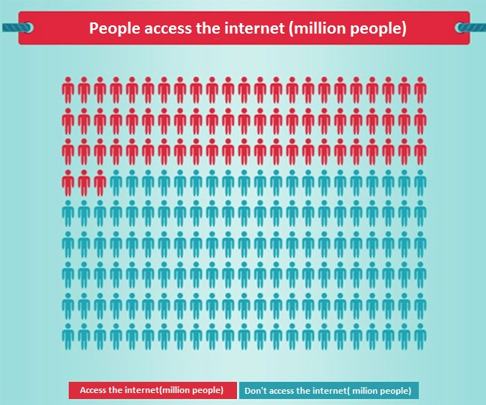
Background
According to the statistics of Vietnam E-Commerce and Information Technology Agency, in 2013 the population of Viet Nam is up to 90 million, in which 36%(31,3 million people) Internet access and more than half of this is shopping online

Slide 6
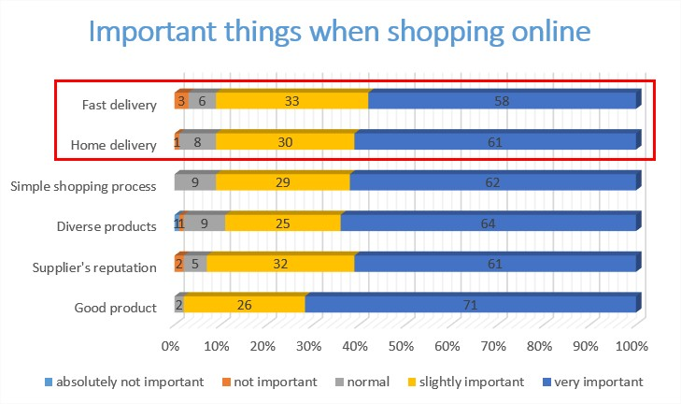
Background
61% of people said that home delivery is very important when shopping online.
58% said that fast delivery is very important.

Slide 7
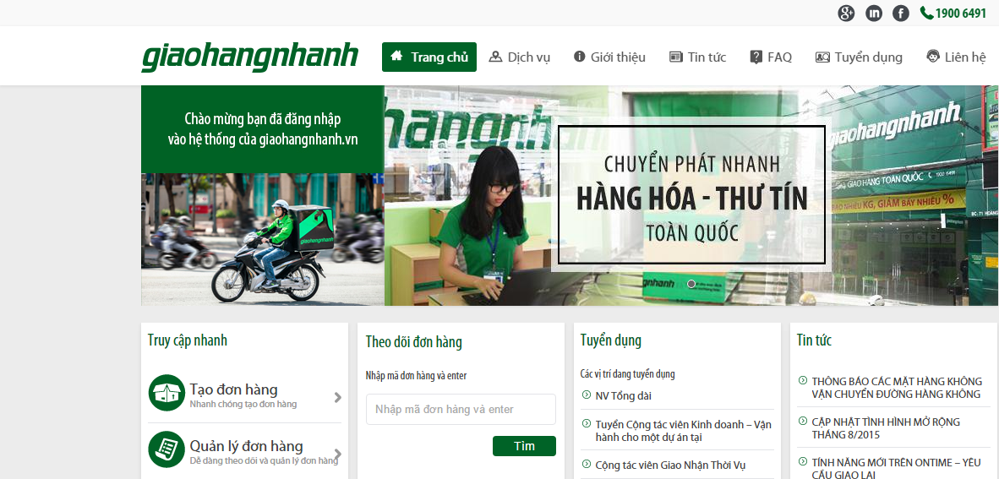
Literature review
Giaohangnhanh.vn
Pros:
Well know brand image in Vietnam
Having many shippers, system can receive lots of orders
Low price
Cons:
Track order function is not well interface, just use text to display status (Wait, Shipper is comming, Shipping, Done)
Don’t have express delivery service.
Don’t have mobile app for shipper to find the way.

Slide 8
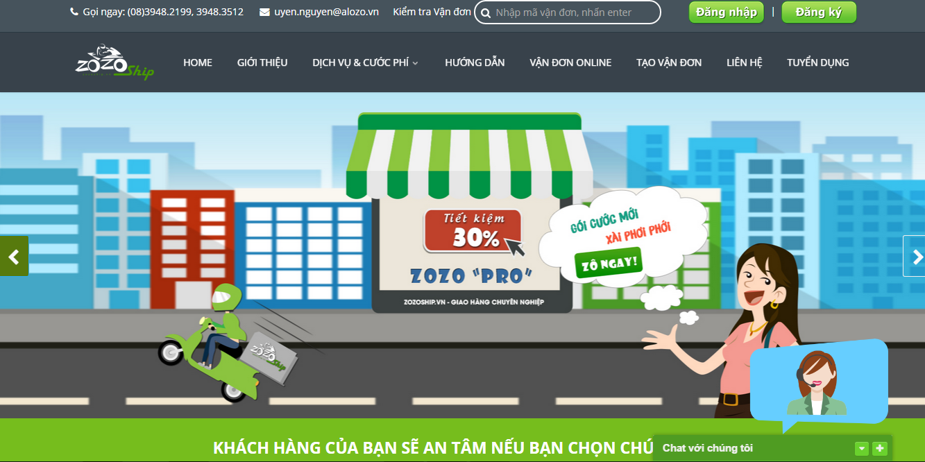
Literature review
Zozoship.vn
Pros:
Track order status on website
Many service pack with clearly information
Nationwide delivery
Goods insurance
Cons:
Working are: only Ho Chi Minh city
Don’t apply technology to immediately find the nearest shipper to the order.
Track order function is not well interface, just use text to display status

Slide 9
Proposal
We’ll develop a system that include 4 part:
Part 1: Web application for store that support store’s employee everything they need to create an order, verify shipper who come to takes goods. Store also knows location of shipper (goods) on maps.
Part 2: Mobile-application for shipper that support shipper view information of order,. Beside, shipper can notify to system if have issue while delivering.
Part 3: Web application for admin that help system managers manage shipper, store, transaction history and know about issue of delivery process.
Part 4: Web service that save all information of store, shipper and transaction history.

Slide 10
Project Mangement (プロジェクト管理)
II
2.1. Software Process Model
ソフトウェ アプロセス モデル
2.2.Project Organization
プロジェクト組織
2.3. Project Schedule
プロジェクト計画
2.4. Objectives & deliverables
目標 と 成果物
2.5. Tools & Infrastructure
ツールと インフラストラクチャ
2.6. Risks management
リスク管理
2.7. Configuration management
コンフィグレーション管理
2.8. Communication management
コミュニケーション管理

Slide 11
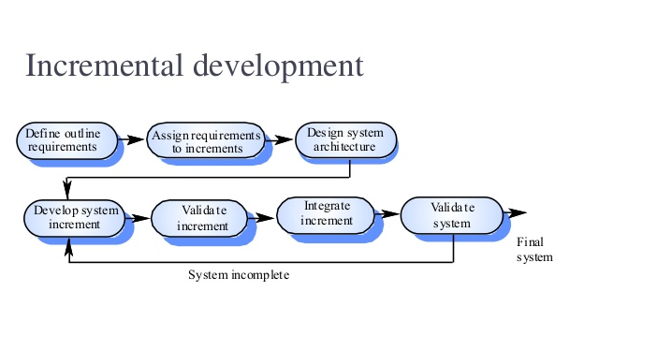
2.1 Software Process Model - ソフトウェアプロセスモデル
Some main functions can be developed early & quickly
More flexible - Easy & less costly to change if having.
Testing and debugging during smaller iteration is easy
Iterations may be run simultaneously. A design team starts the next iteration while the current one is under test
The project team learns from first iterations and may use best practices and experiences in next iterations
Easier to manage risk because risky pieces are identified and handled during its iteration.

Slide 12
2.2 Project Organization - プロジェクト組織
Tran Binh Duong
Supervisor
Le Van Quy Hoang
PM
Nguyen Khac Hoang
Technical Leader
Nguyen Thi Hong Nhung
Test Leader/QA
Tran Dinh Hoang Huy
Developer
Nguyen Van Quyen
Developer
Kieu Cao Khanh
Developer
Le Van Quy Hoang
Developer

Slide 13
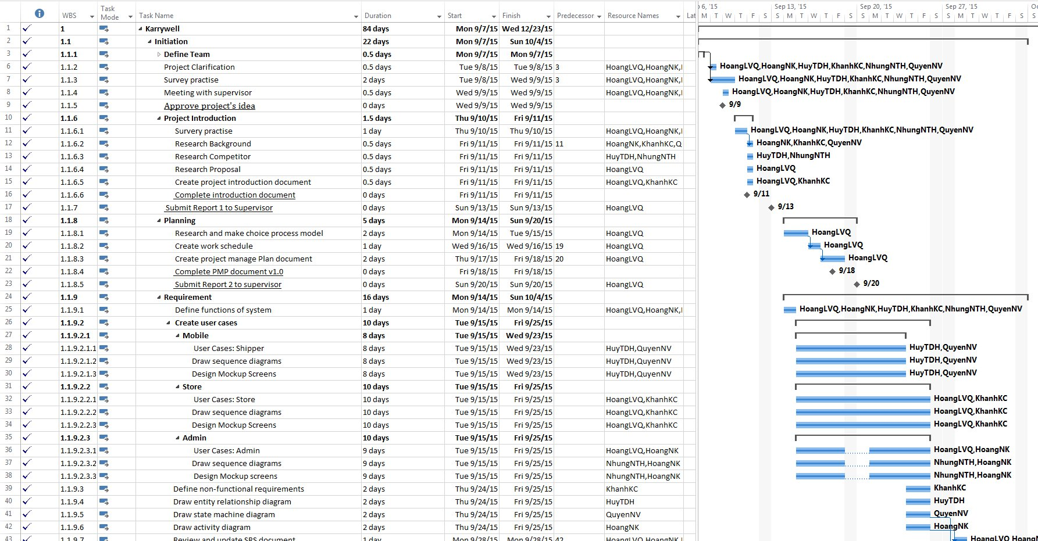
2.3 Project Schedule - プロジェクト計画

Slide 14
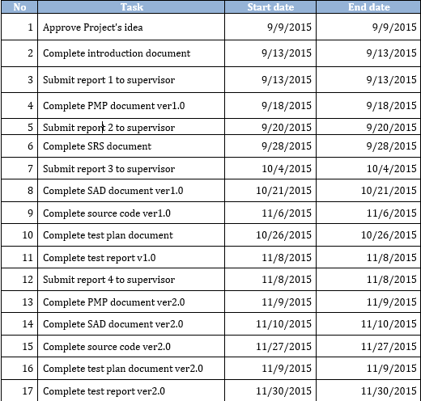
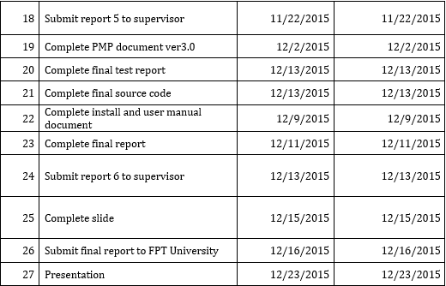
2.4 Milestones & deliverables - マイルストーンズと成果物

Slide 15
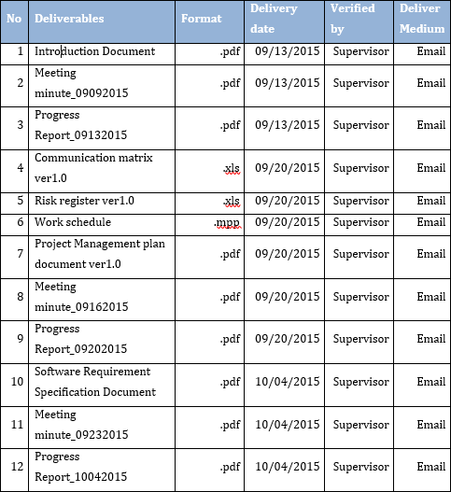
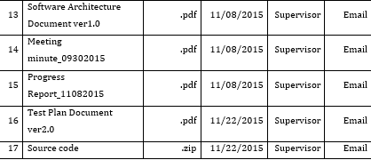
2.4 Milestones & deliverables - マイルストーンズと成果物

Slide 16










2.5 Tools & Infrastructure - ツールと インフラストラクチャ
Tools
Tools for project management
SourceTree
Word 2013
Excel 2013
Project 2013
Power Point 2013
Tools for developing
WebStorm
pgAdmin
Excel 2013
Project 2013
Power Point 2013

Slide 17
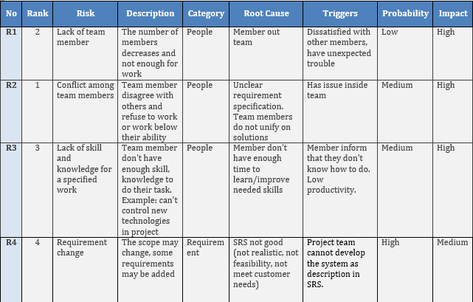
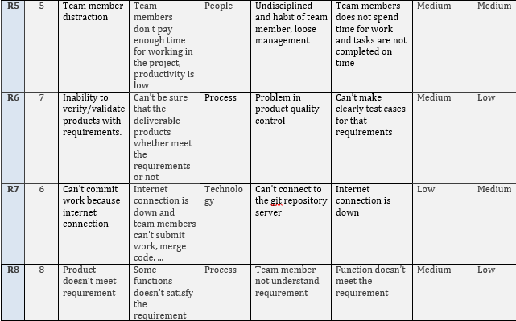
2.6. Risks management -リスク管理

Slide 18
4. Software Design (ソフトウェア設計)
4.1. Technology and Reason
テクノロジーと理由
4.2.Architectural Representation
アーキテクチャ表現
4.3. Database Design
データベース設計
4.4. Screen Design
画面の設計
4.5. Class Diagram
クラス図
4.6. Sequence Diagram
シーケンス図

Slide 19
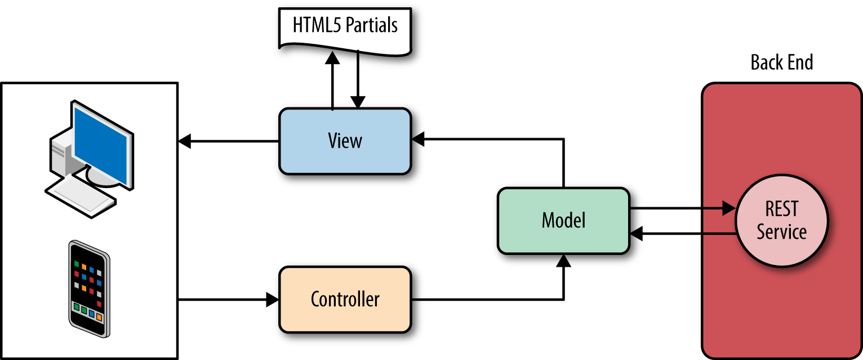
4.1. Technology and Reason -テクノロジーと理由
Mobile application
Because we want to create an application that build once but run on many platform mobile (IOS, Android...). Therefore we choose the IONIC framework to create a hybrid application. This framework uses Angular which allows us easy to develop application following MVC model.

Slide 20
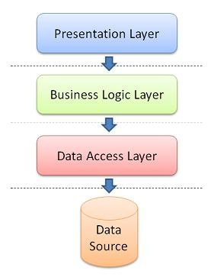
4.1. Technology and Reason -テクノロジーと理由
Web application : N-layers model
The benefits of N-layer model:
Other applications will be able to reuse the functionality exposed by layers
The maintenance of application is easier because of the low coupling between layers.
It's easy to distribute layers over multiple physical tiers. This can make a very good impact on application by improving performance (sometimes), scalability and fault tolerance.
Layers make your application more testable.

Slide 21
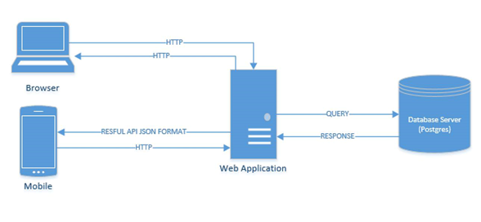
4.2. Architectural Representation - アーキテクチャ表現
Overview of Karywell system

Slide 22
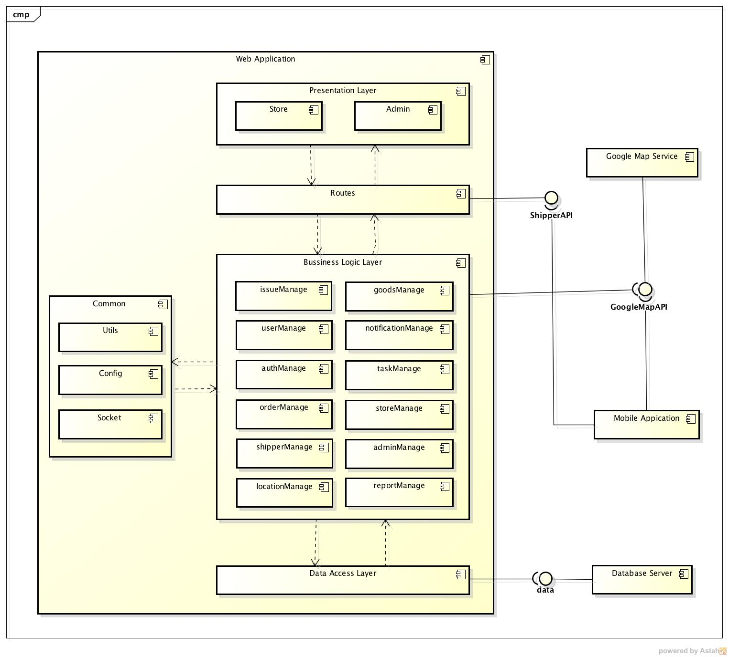
4.2. Architectural Representation - アーキテクチャ表現
Component Diagram

Slide 23
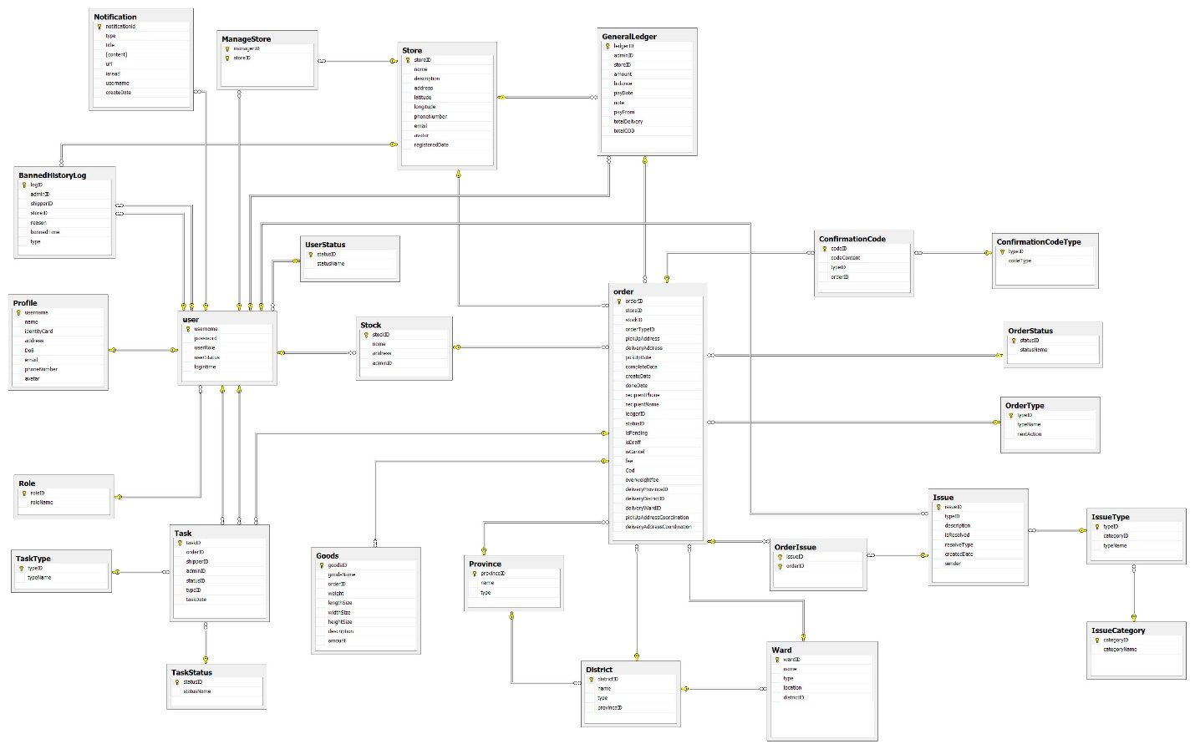
4.3. Database Design - データベース設計

Slide 24
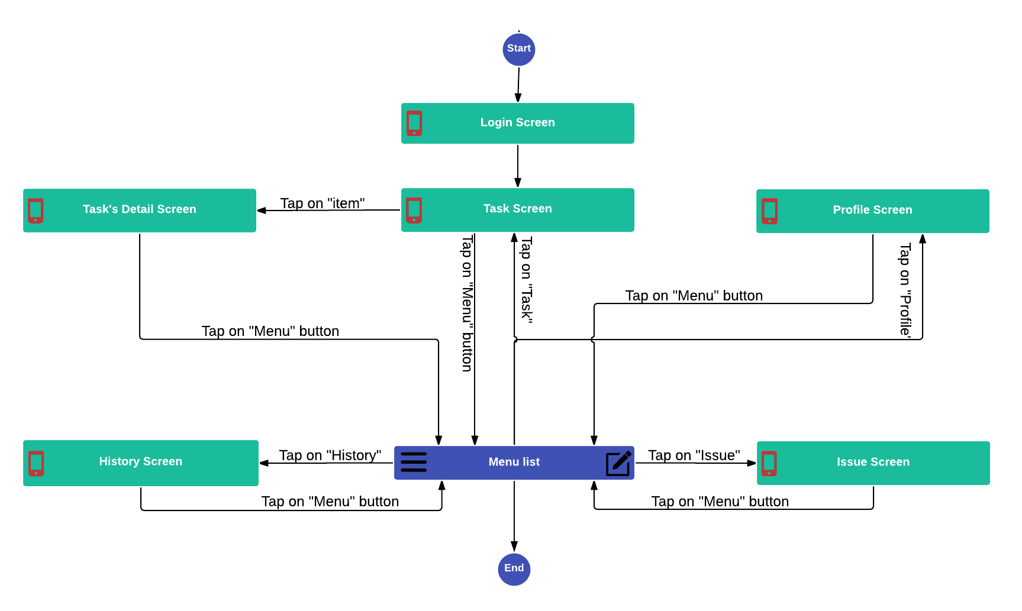
4.4. Screen Design- 画面の設計
4.4.1. Screen Flow - 画面の流れ
Mobile Screen Flow

Slide 25
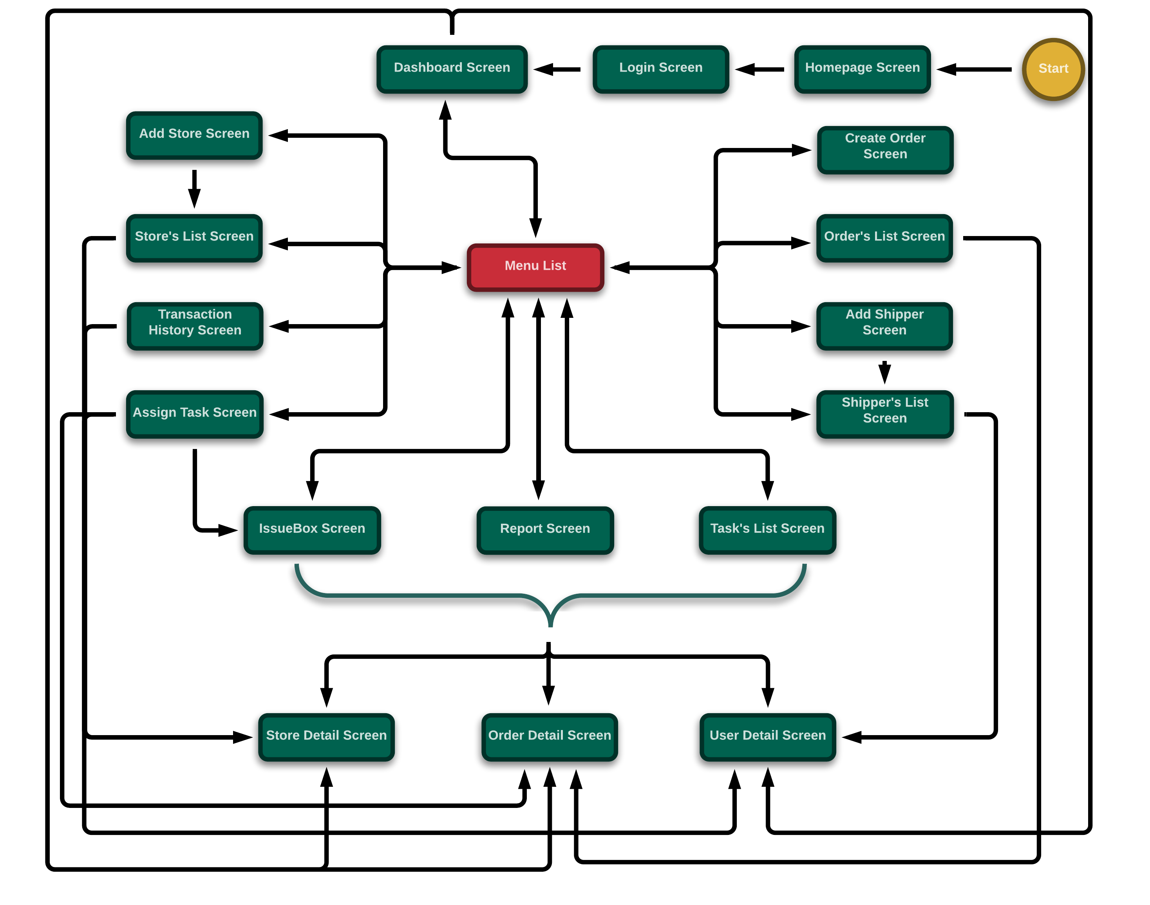
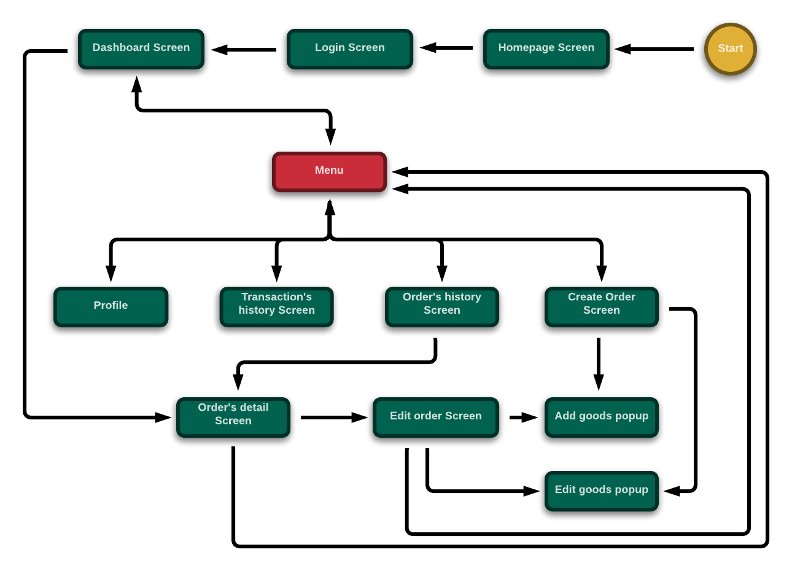
4.4. Screen Design- 画面の設計
4.4.1. Screen Flow - 画面の流れ
Client-web for Admin Screen Flow
Client-web for Admin Screen Flow

Slide 26
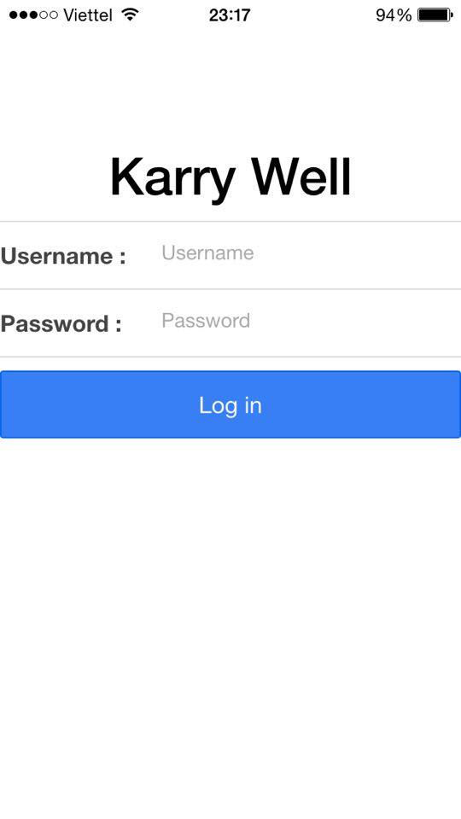
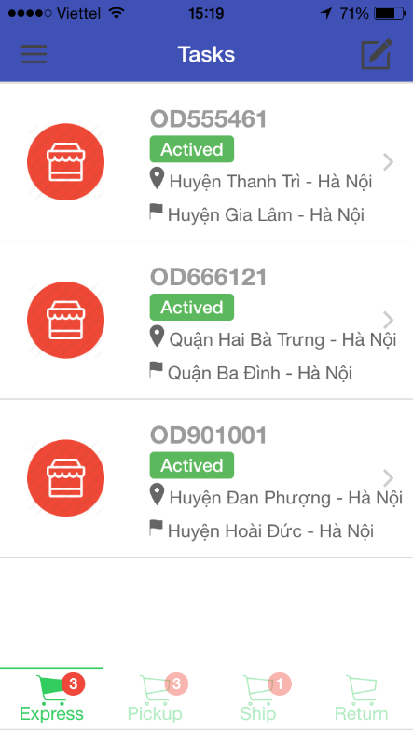
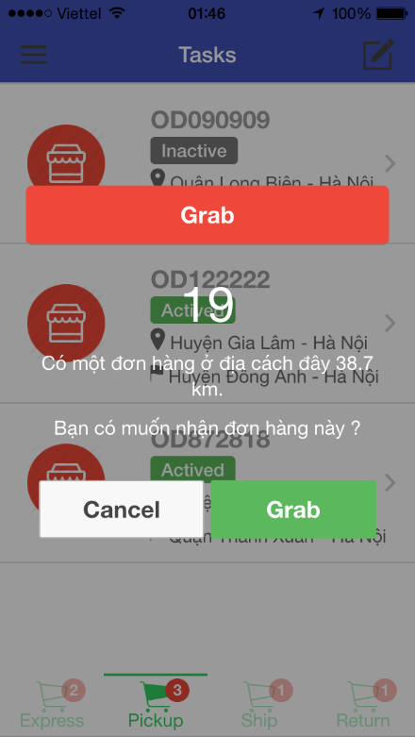
4.4. Screen Design- 画面の設計
4.4.2. Screen Design - 画面の設計
Screen of Mobile Application

Slide 27
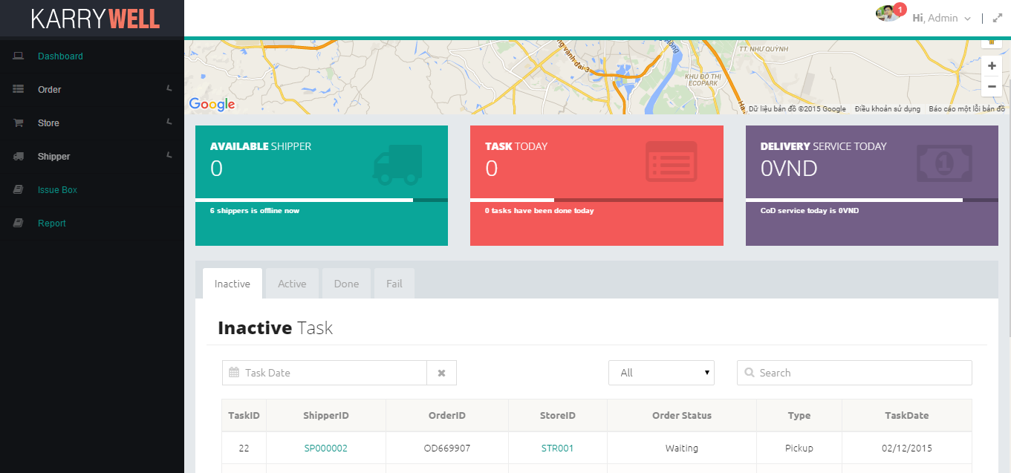
4.4. Screen Design- 画面の設計
4.4.2. Screen Design - 画面の設計
Screen of Client-Web for Admin

Slide 28
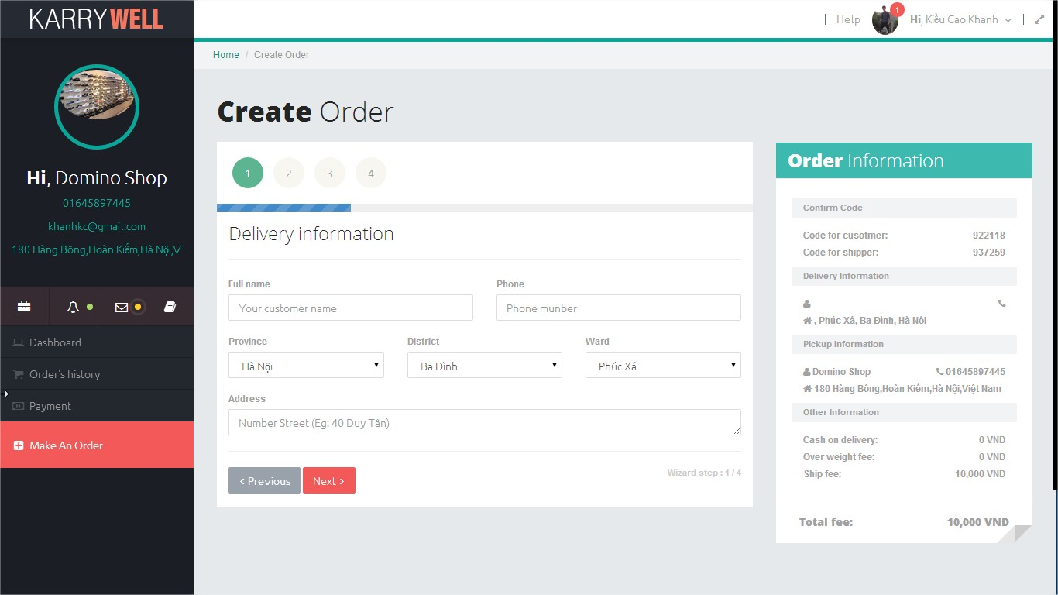
4.4. Screen Design- 画面の設計
4.4.2. Screen Design - 画面の設計
Screen of Client-Web for Store

Slide 29
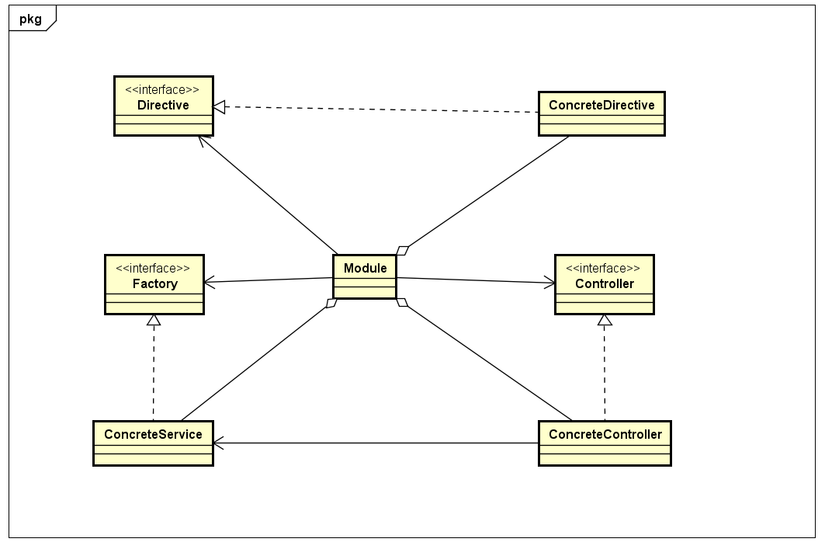
4.5. Class Diagram - クラス図
Class Diagram of Angular Module

Slide 30
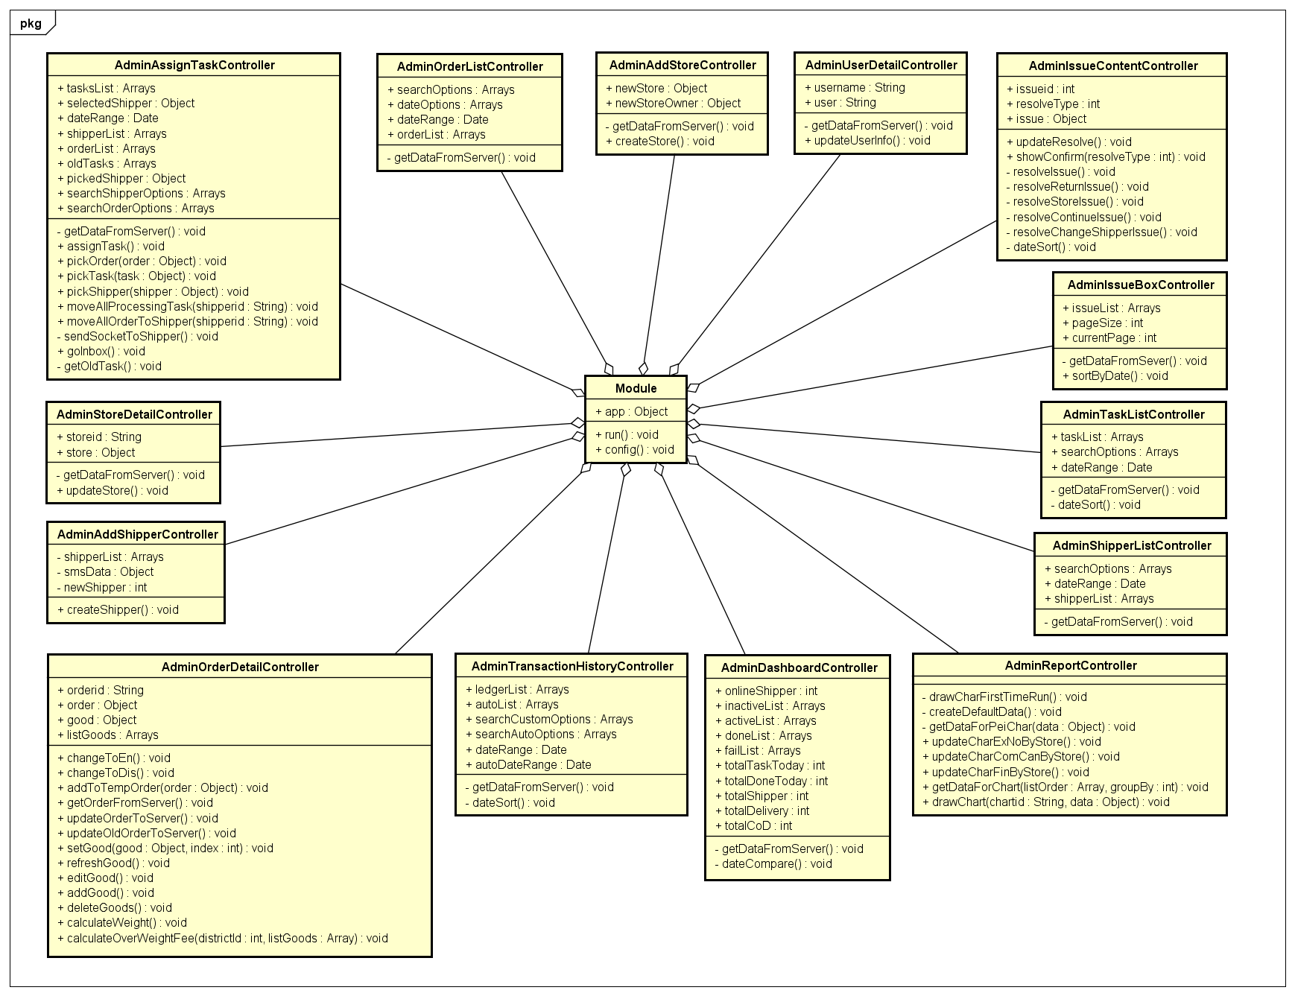
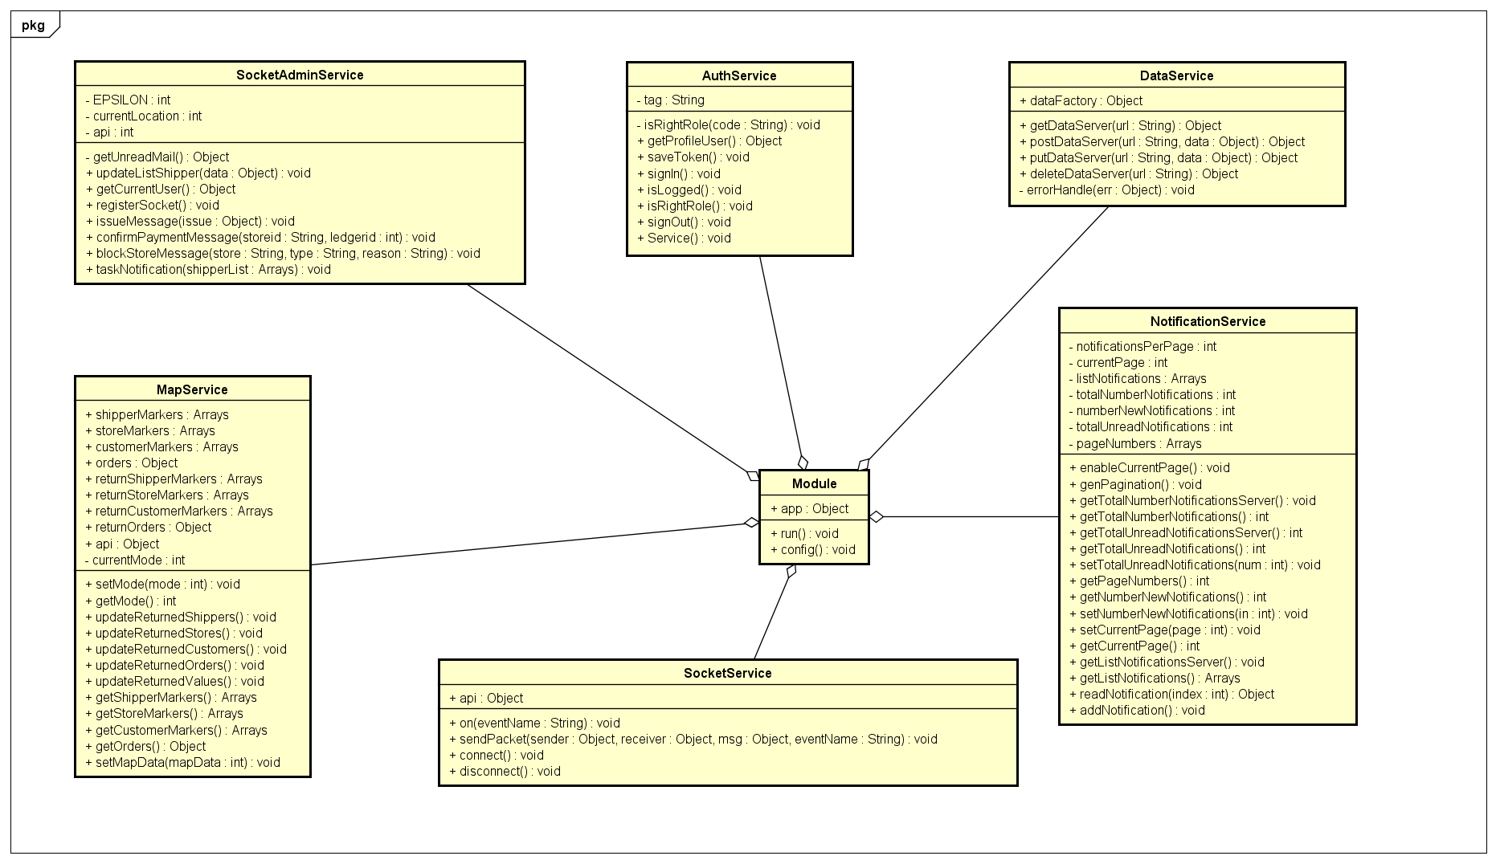
4.5. Class Diagram - クラス図
Class Diagram of Controller for Admin
Class Diagram of Service for Admin

Slide 31
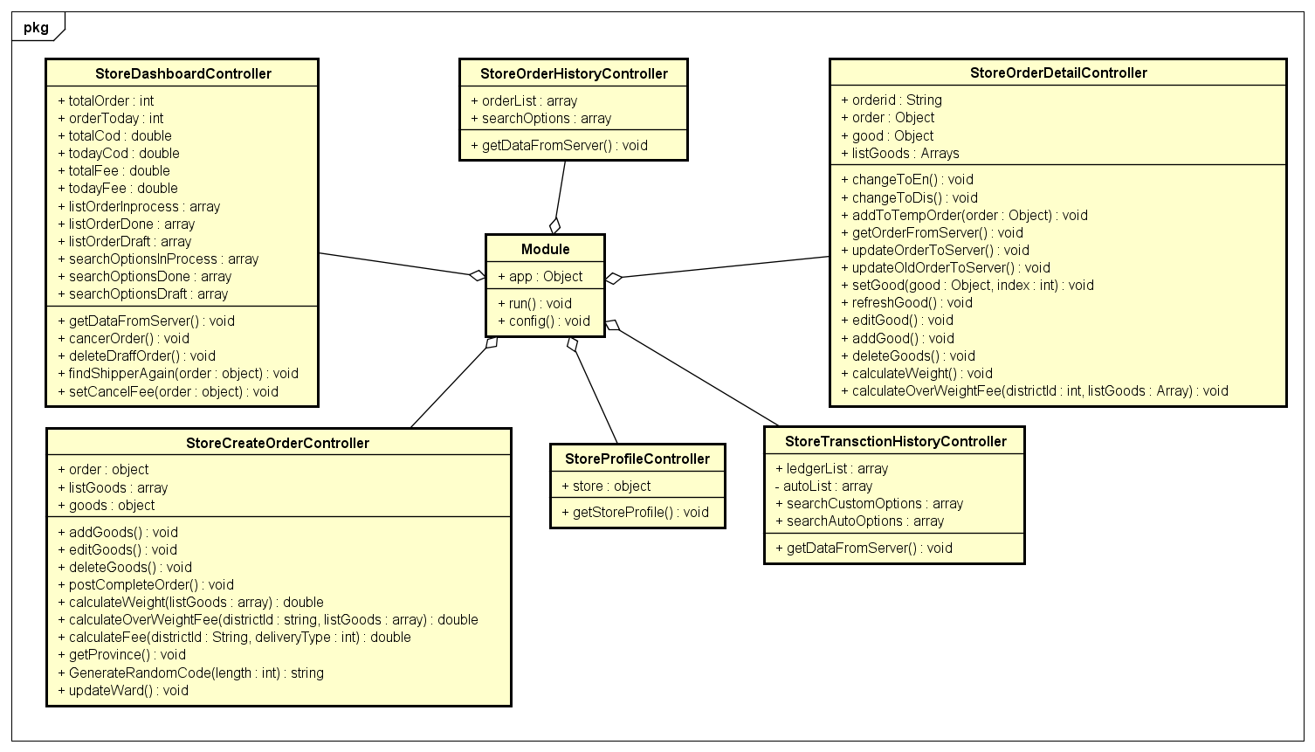
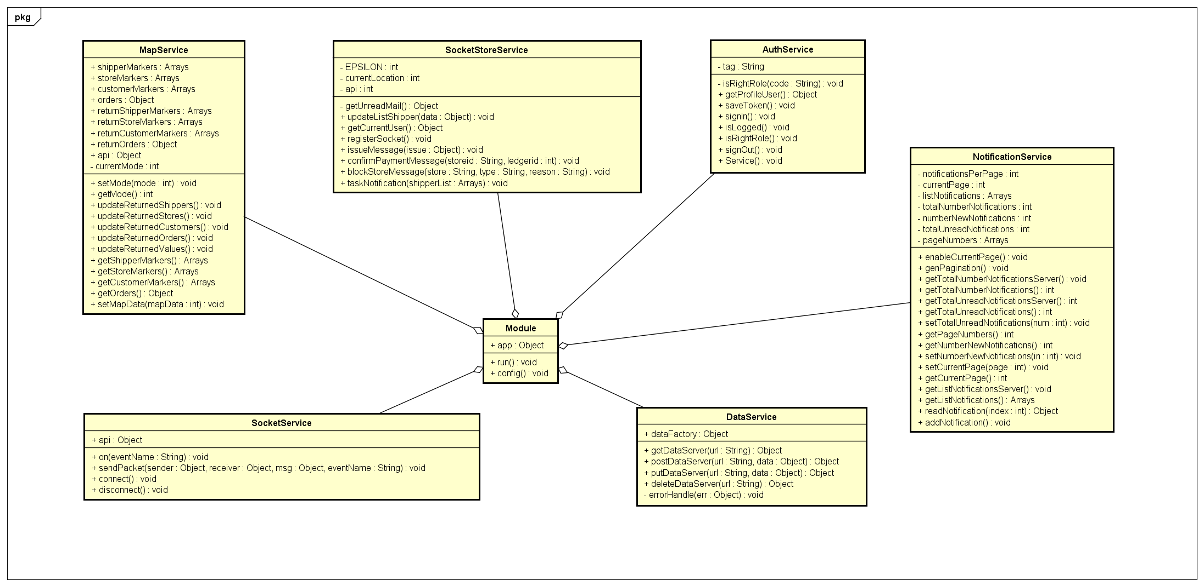
4.5. Class Diagram - クラス図
Class Diagram of Controller for Store
Class Diagram of Service for Store

Slide 32
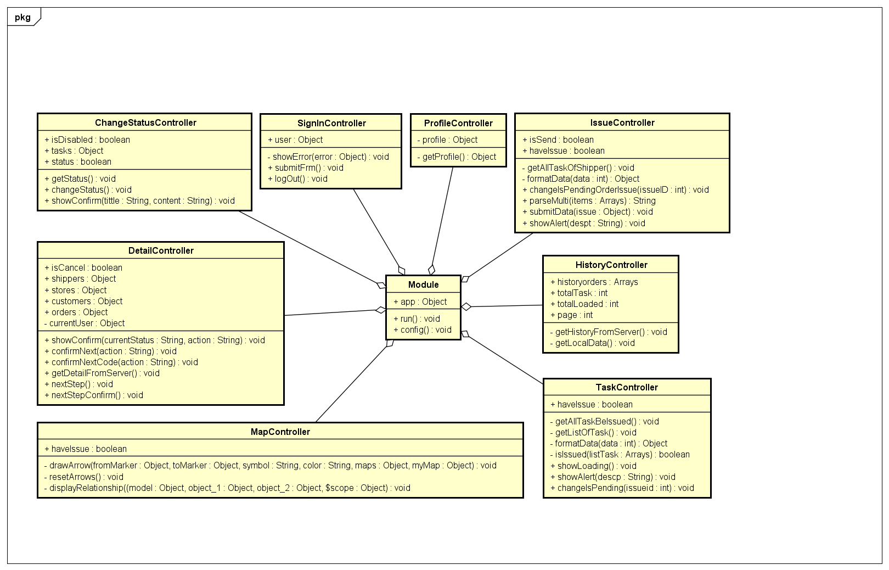
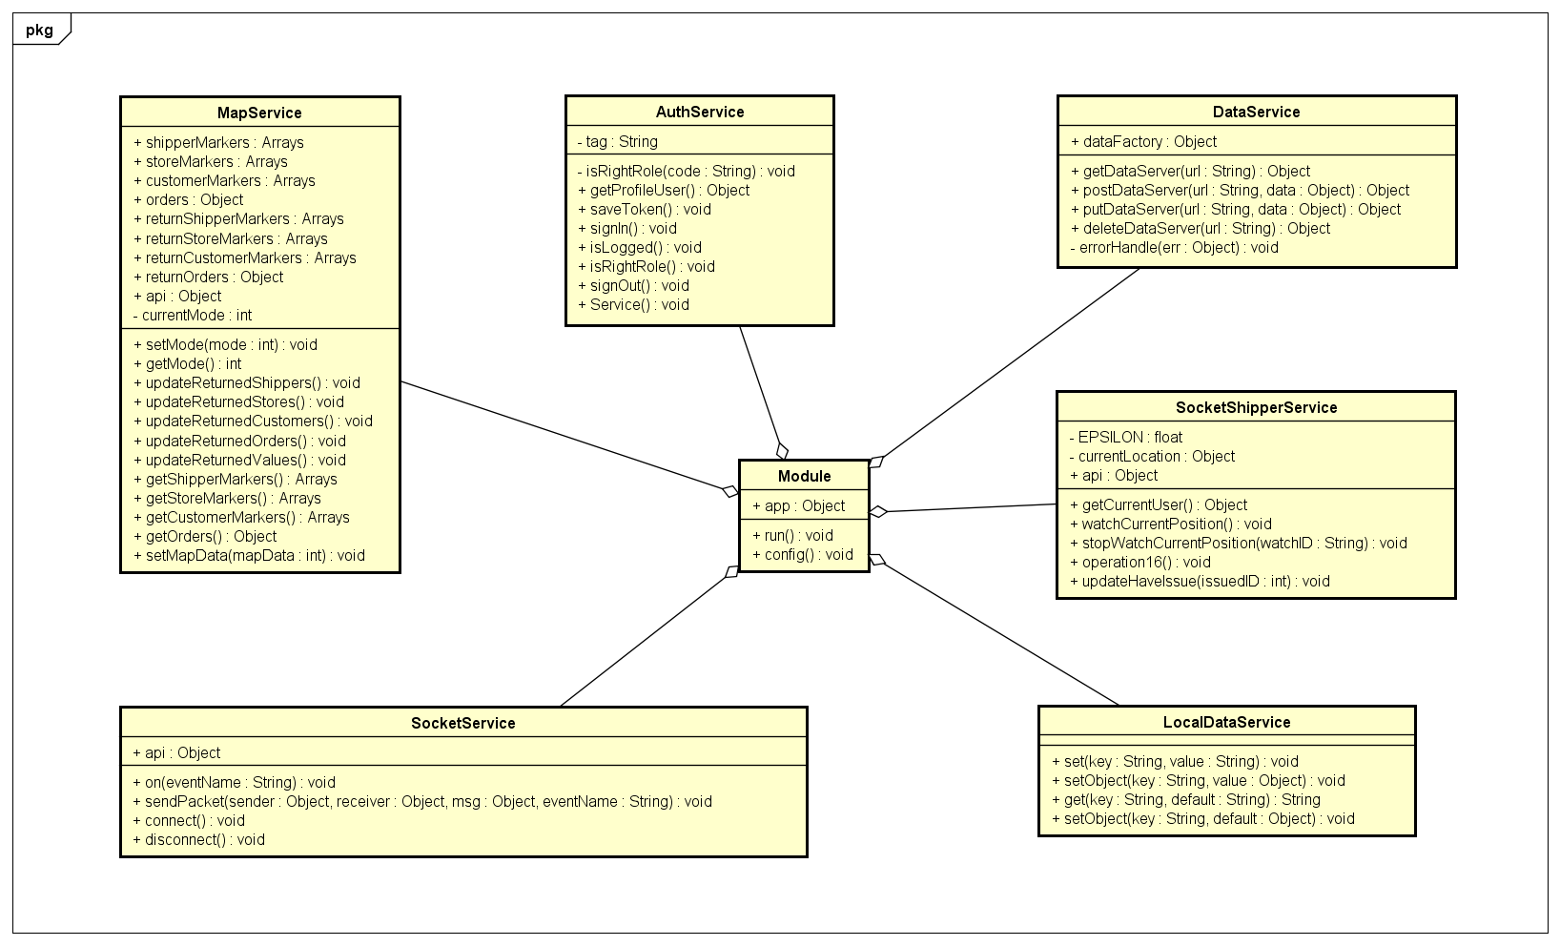
4.5. Class Diagram - クラス図
Class Diagram of Controller for Shipper
Class Diagram of Service for Shipper

Slide 33
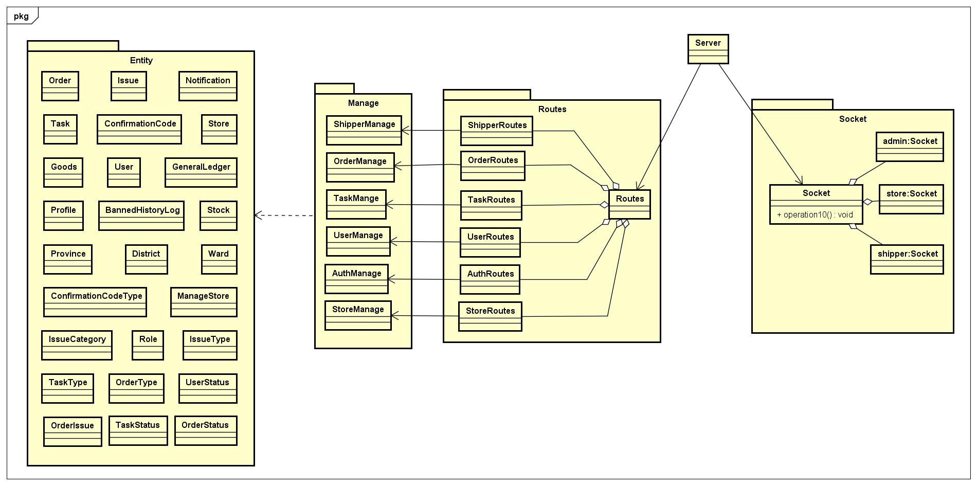
4.5. Class Diagram - クラス図
Class Diagram of Server

Slide 34
6. Project Result (プロジェクト結果)

Slide 35
6. Project Result - プロジェクト結果
Project Summary
Lesson Learn:
Apply all knowledge and skills that we have studied
Improve skills: teamwork, document writing, project management, communication, planning, resolving conflict.
Technical: AngularJS, NodeJS, Ionic Framework, PostgreSQL
Future Work:
Develop more functions: pay fee via banking service, stock management, API for store,…
Improve infrastructure and quality of product

Slide 36
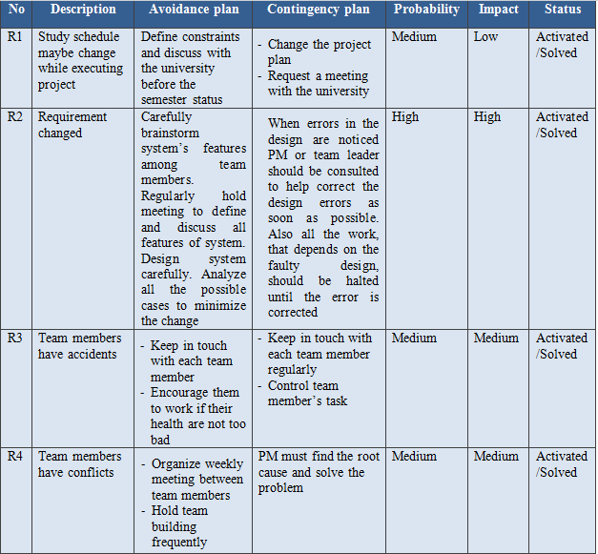
Risk Management
(リスク管理)

Slide 37



Test
テスト
Execute test ４rounds
for every subproject
Meet deadline
締め切りに間に合うタスク計画
Every document must be reviewed
by checklist before deliver
Review
レビュー
Quality Management
品質管理

Slide 38
Requirement Specification (要求仕様)
III
Functional Requirement・機能仕様
Non-functional Requirement・非機能仕様

Slide 39
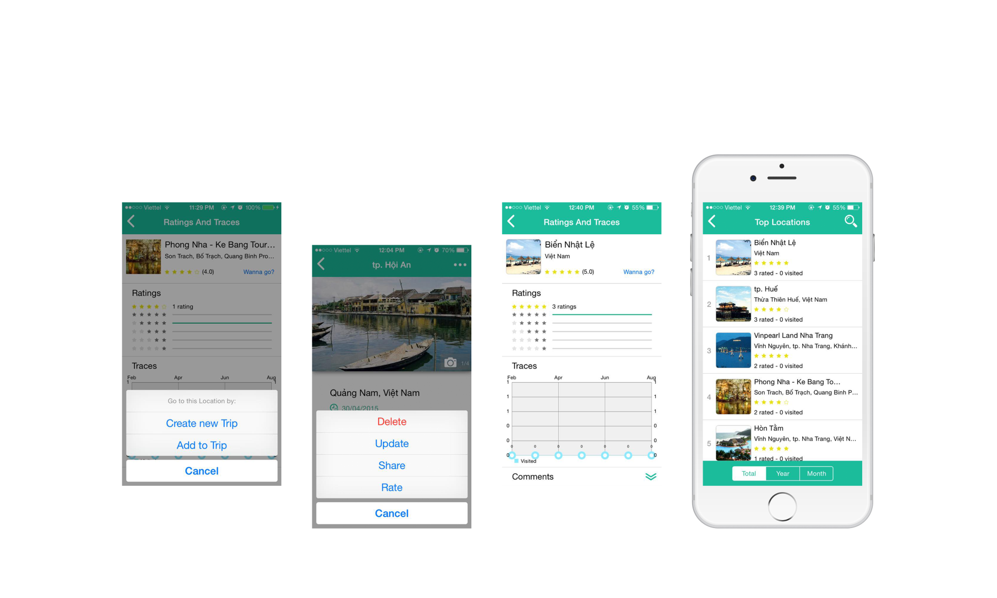
Rating (レイティング)

Slide 40
• Interface should be simple, easy- to-use, clear.
• Provide an introduction to support users.
• User interface will be designed base on Flat Design
• User interface must be attractive to make a motivation for users
Usability
有用性
Performance
性能
• Maximum response time for display information must be less than 0.5s
Availability
可用性
• Percentage of availability time is about 24/7
• The output of the project must include naming conventions and coding standards documentations. Code implementation must be easy to maintain.
• All code must be comment clearly, including class and method documentations.
• The design of the system must be loosely coupled that chances on some module will not affect others.
Maintainability
& Extension
保守性と拡張子
Non-functional Requirement
非機能仕様

Slide 41
Software Design (ソフトウェア設計)
IV

Slide 42
Content -内容
Overall System Architecture
(全体的なシステムアーキテクチャ設計)
Application Architecture Design
(アプリケーションアーキテクチャ設計)
Screen Design
(画面設計)
Application Logical View
(アプリケーションの論理ビュー)
Data Design
(データ設計)

Slide 43
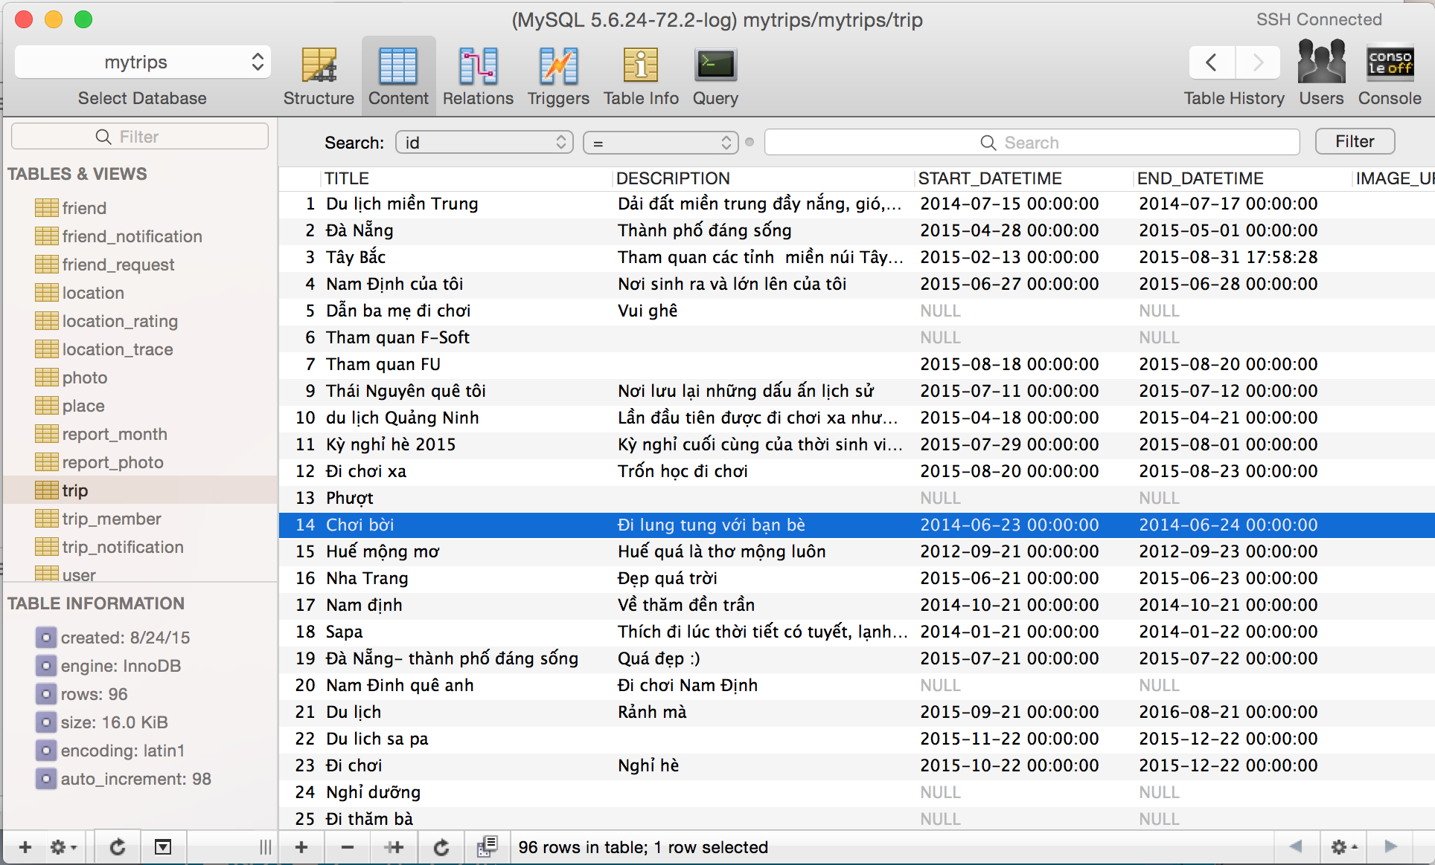
Database sample
データベース サンプル

Slide 44
Implementation (インプリメンテーション)
V
Development Environment・開発環境
Deployment Environment・展開環境
Coding Convention・コーディング規約
Source Code Review・ソースコード レビュー

Slide 45
Quality control (品質管理)
VI
Testing ・ Test Model ・ テスティング
Test Stage・テスト段階
Test Case・テストケース
Test Report ・テスト実行報告
Bug List ・バーグリスト

Slide 46
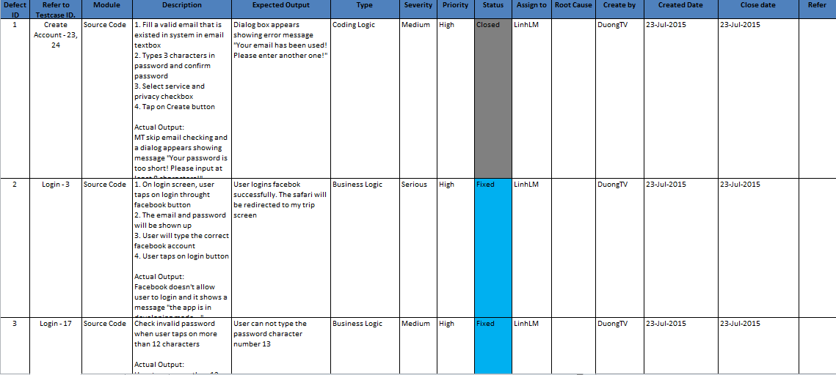
Bug List
バーグリスト

Slide 47
Summary (概要)
VII
Future Development・拡張機能
Lesson Learned・学んだこと

Slide 48
Demo (デモ)
VIII

